Slide 1

Sink or Swim
Using Machine Learning to Predict Titanic Passenger Survival
Floriane Beyegue, Josh Jagget, Cassandra Johnson, Antonio Pinkston, Rajiv Shrestha

Slide 2
The Challenge
The sinking of the Titanic is one of the most infamous shipwrecks in history.
On April 15, 1912, during her maiden voyage, the widely considered “unsinkable” RMS Titanic sank after colliding with an iceberg. Unfortunately, there weren’t enough lifeboats for everyone onboard, resulting in the death of 1,502 out of 2,224 passengers and crew.
While there was some element of luck involved in surviving, it seems some groups of people were more likely to survive than others.
Data Provided by a Kaggle Competition on Machine Learning

Slide 3
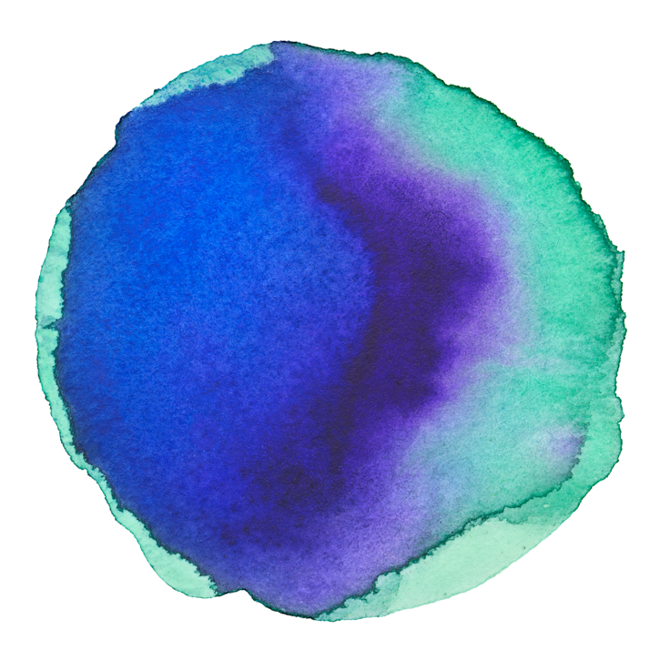
Use Features of Titanic Passengers to Predict Survival Outcomes
Summary and Objectives
Build and Compare Several Machine learning Models to find the most Effective Model
Apply the Most Accurate Model to the Testing Data

Slide 4
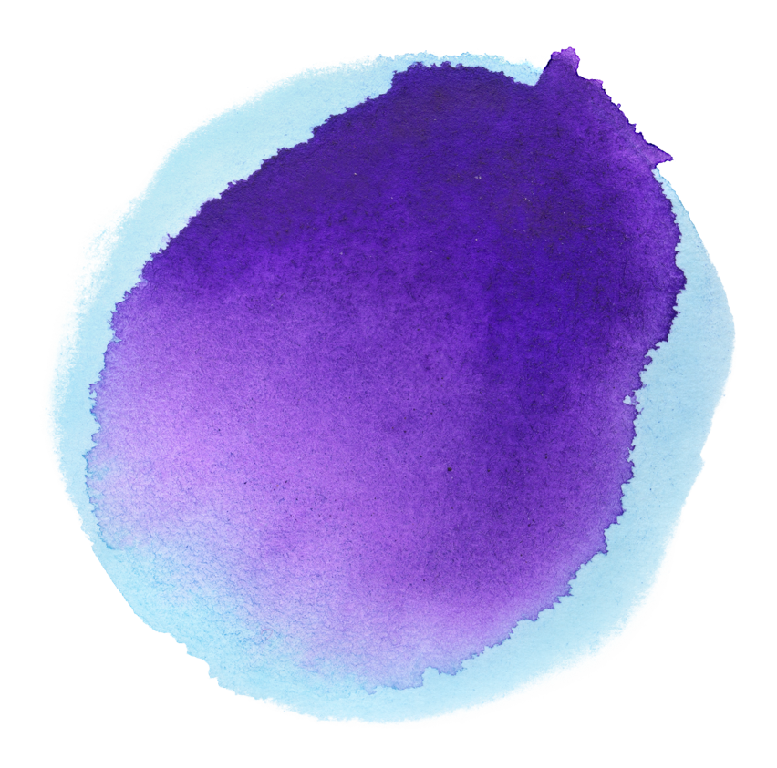
Data Set
Training Set
Testing Set
Information for 892 Passengers with survival outcomes provided.
Used to build and test ML models
Because the training set had survival rates, we used this dataset to train/test all models to determine the most effective model.
Information for 418 Passengers without survival outcomes provided.
We used the testing set to predict survival rates using the model we determined most effective

Slide 5

Data Features
Sex
# of Siblings and Spouses
# of Parents and Children
Passenger ID
Fare
Age
Name
Cabin Number
Survived
Embarkation
Location
Passenger Class
Ticket Class

Slide 6
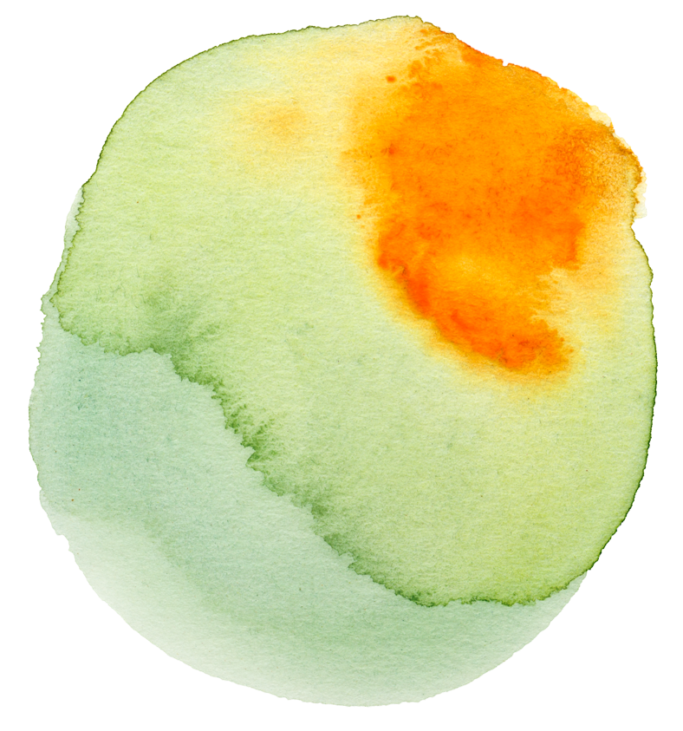
Analyze and Clean the Data
Step 1
Step 2
Step 3
Analyze the Raw Data -
38.4% of total passengers survived. Initial analysis of data features and variables
Remove useless data -
Will not use PassengerID, Name, Ticket, and Cabin fields
Prep data for ML -
Digitize data
Resolve missing data
Convert all fields to int64

Slide 7
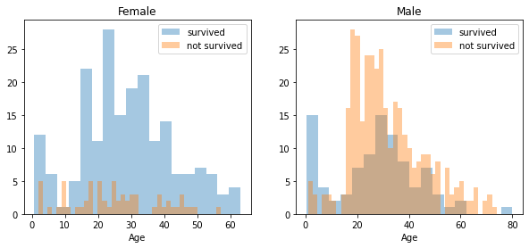
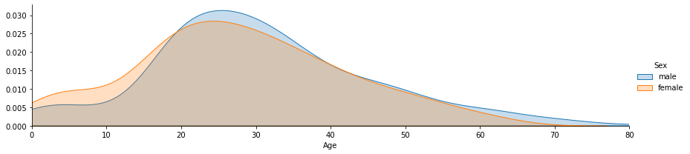
Data Analysis Visualizations

Slide 8
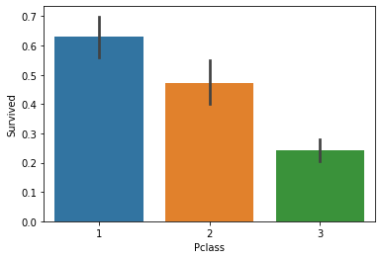
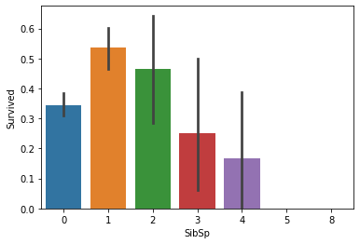
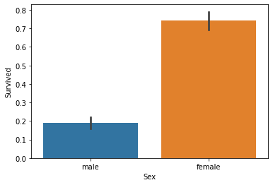
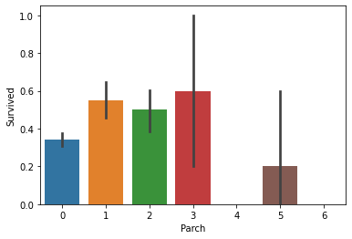
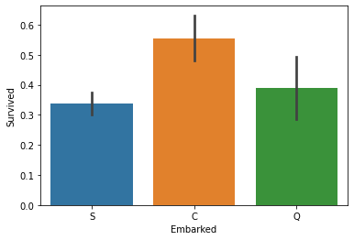
Data Analysis Visualizations
Ideal Survivor: Female travelling Pclass 1 w/ family embarking at Cherbourg

Slide 9
Model Introduction
Step 1
Step 2
Step 3
Selected 7 machine learning models to run 8 analyses
Logistic Regression, SVM, Decision Trees, Random Forest, GaussianNB, MlpClassifier, & Neural Networks
Each model utilized the same 10 features and 1 target variable (Survival)
Utilized the same random state of 78 to achieve replicable train-test-splits

Slide 10

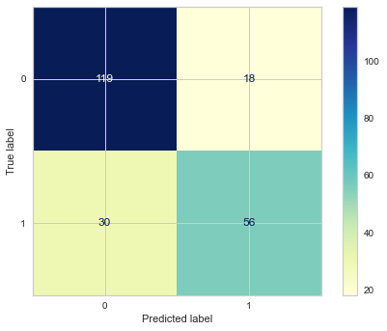
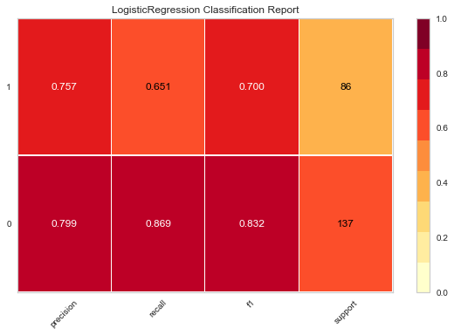
Machine Learning Models - Logistic Regression
Confusion Matrix
Classification Report
0 - Did not Survive
1 - Survive
Accuracy: .78

Slide 11
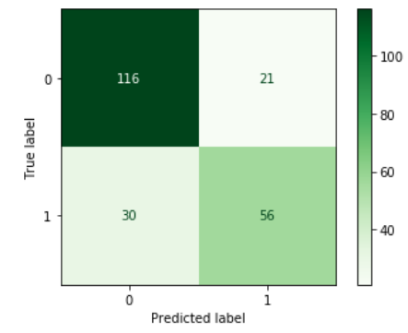
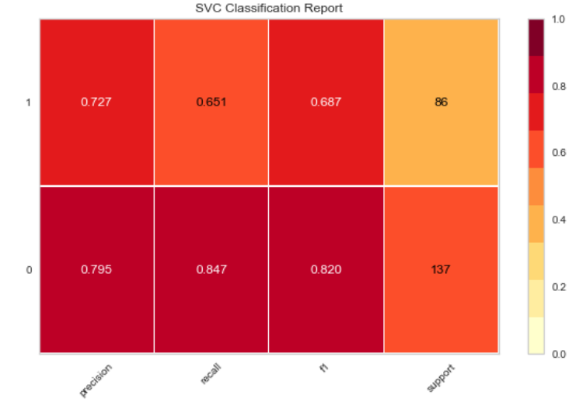
Support Vector Machine (SVM)
Confusion Matrix
Classification Report
0 - Did not Survive
1 - Survive
Accuracy: .77

Slide 12
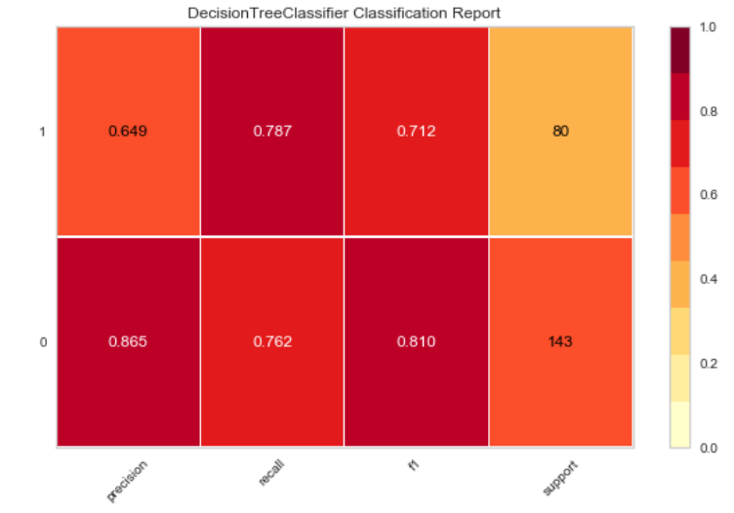
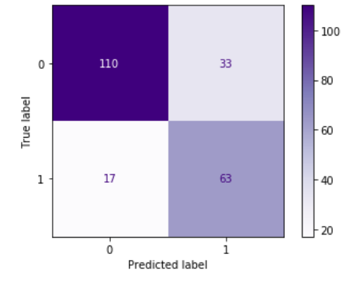
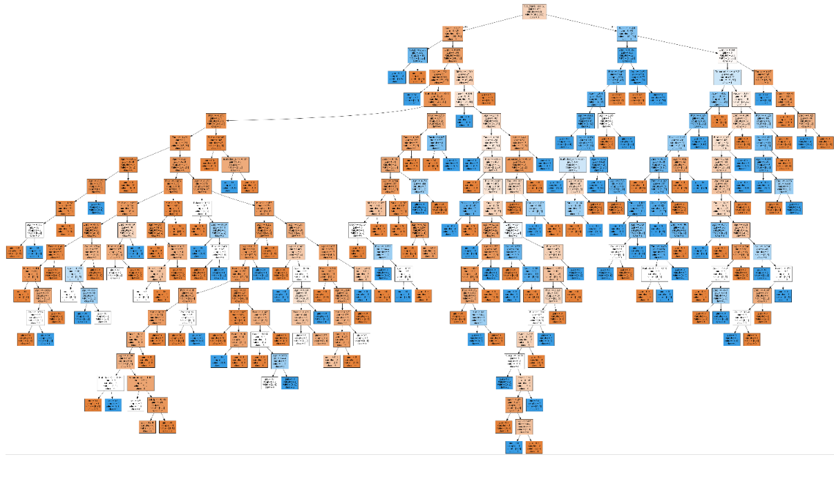
Decision Tree
Confusion Matrix
Classification Report
0 - Did not Survive
1 - Survive
Accuracy: .78
Decision Tree

Slide 13
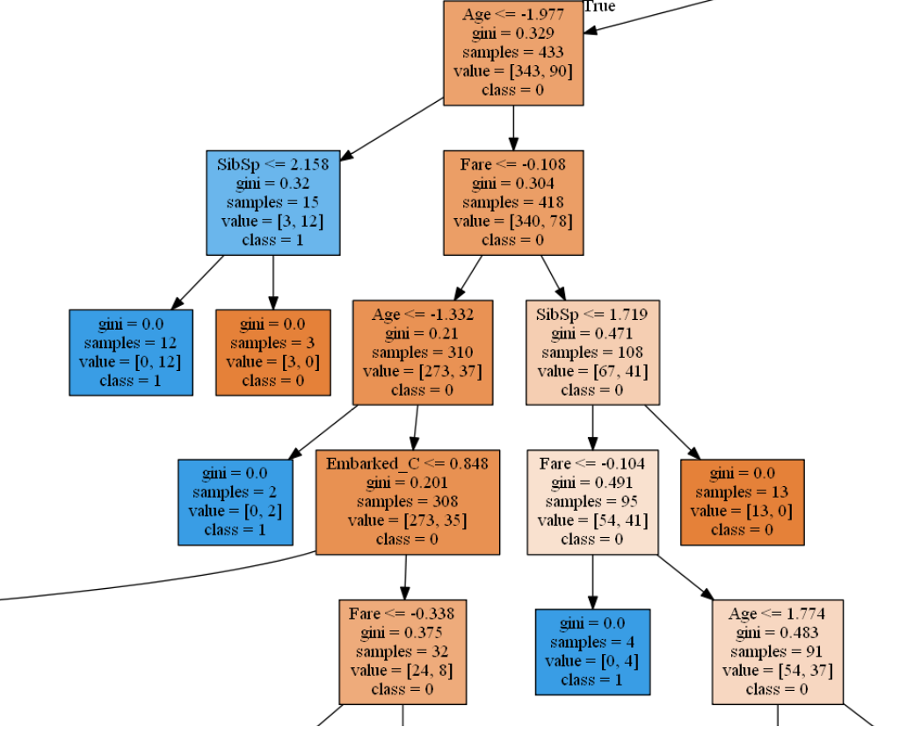

Slide 14
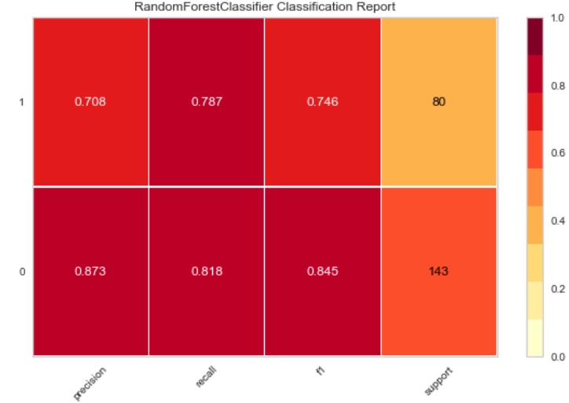
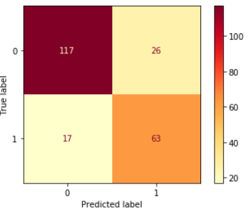
Random Forest
Classification Report
Confusion Matrix
0 - Did not Survive
1 - Survive
Accuracy: .81

Slide 15
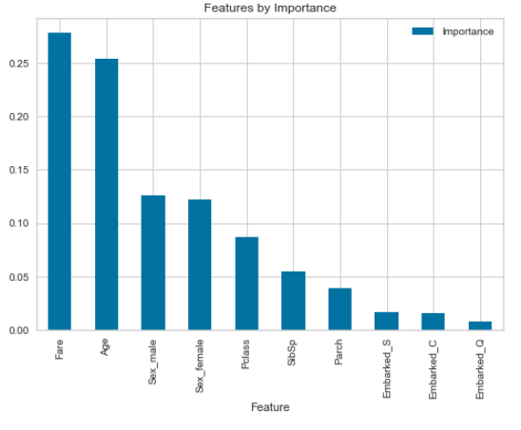
Random Forest
Key Features

Slide 16
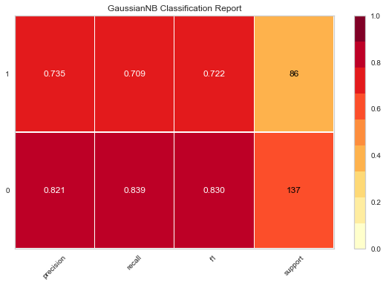
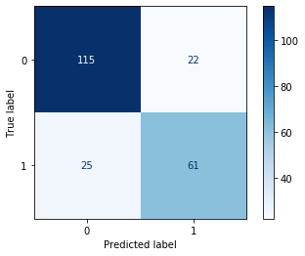
GaussianNB
Classification Report
Confusion Matrix
0 - Did not Survive
1 - Survive
Accuracy: .79

Slide 17
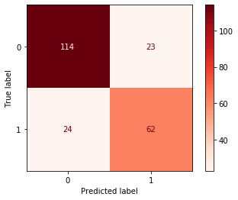

MlpClassifier
Confusion Matrix
Classification Report
0 - Did not Survive
1 - Survive
Accuracy: .79

Slide 18
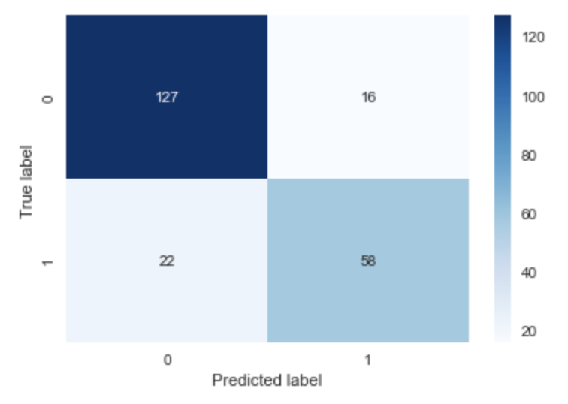
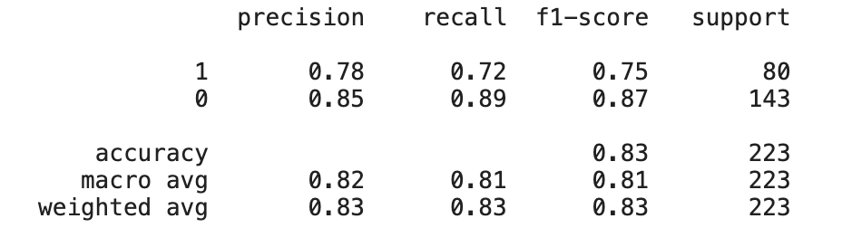
Neural Network - More Nodes, One Layer
Confusion Matrix
Classification Report
0 - Did not Survive
1 - Survive

Slide 19
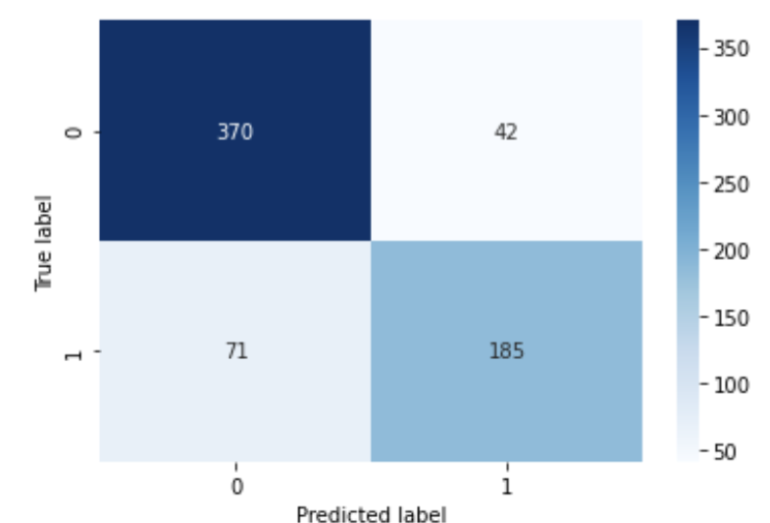
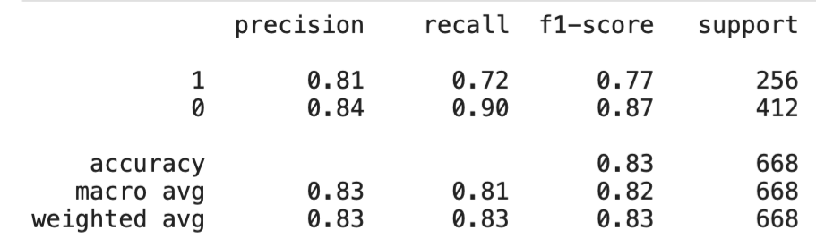
Neural Network - More Layers, Less Nodes - Train Heatmap
0 - Did not Survive
1 - Survive

Slide 20
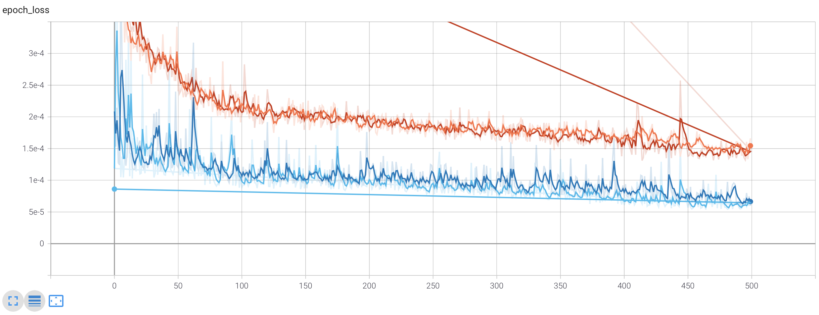
Neural Network - More Layers, Less Nodes - Loss
tensorboard 2

Slide 21
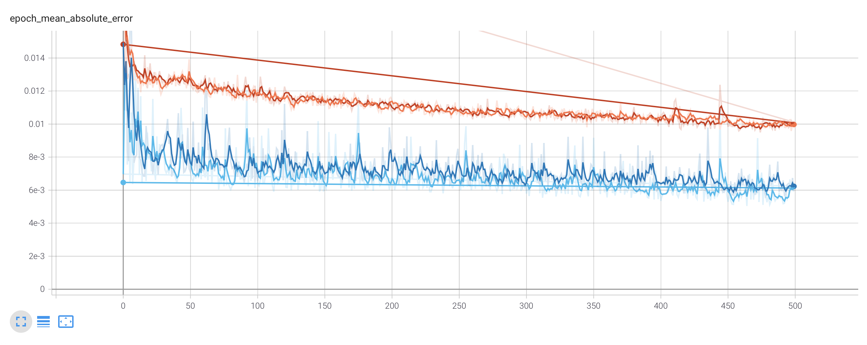
Neural Network - More Layers, Less Nodes - Error

Slide 22

Comparing Model Performance
 | LR | SVM | GNB | MLP | DT | RF | NN1 | NN2
Accuracy | .78 | .77 | .79 | .79 | .78 | .81 | .83 | .83
Precision | .78 | .76 | .78 | .78 | .76 | .79 | .82 | .83
Recall | .76 | .75 | .77 | .78 | .79 | .80 | .81 | .80

Slide 23
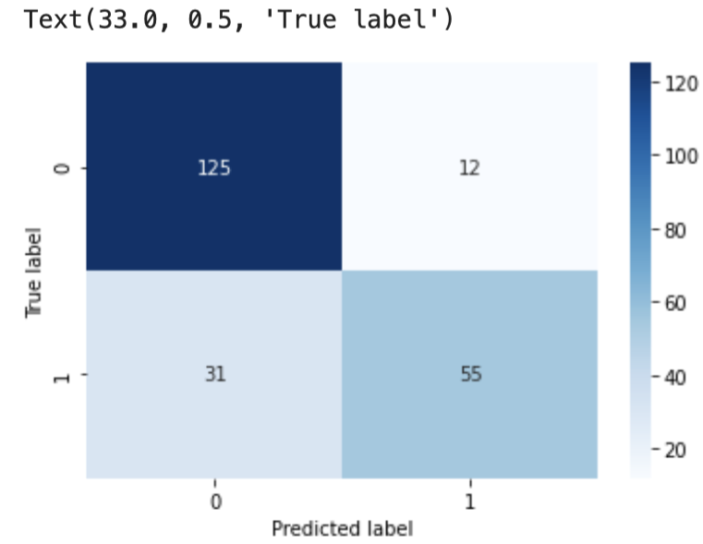
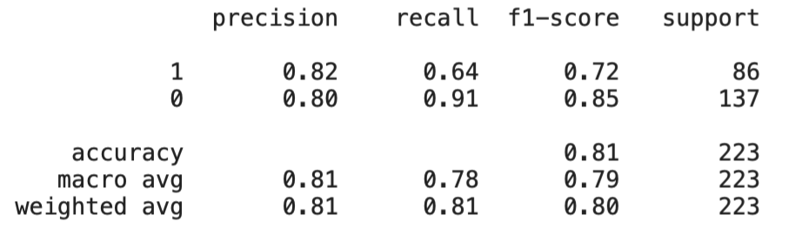
Neural Network - More Layers, Less Nodes - Test Heatmap & Report
0 - Did not Survive
1 - Survive

Slide 24
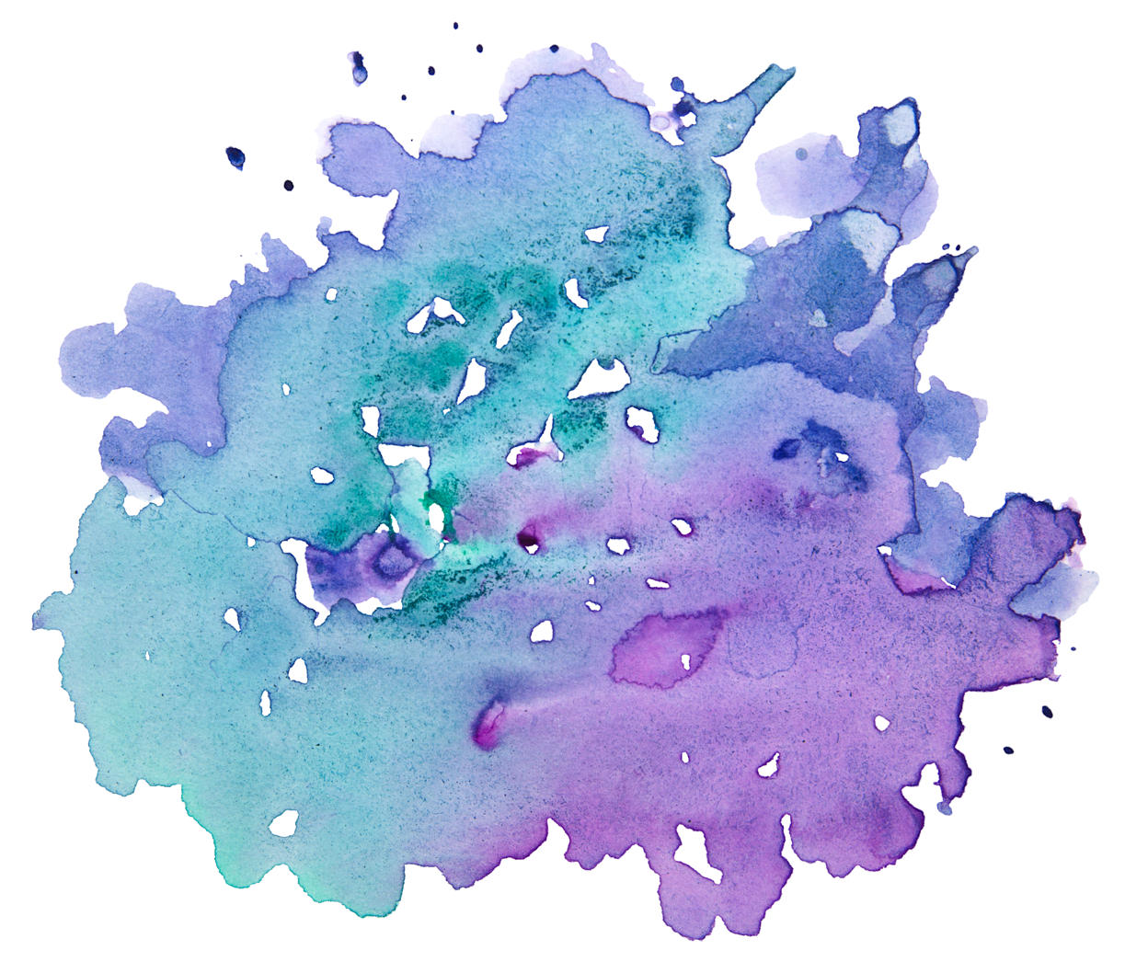
Conclusion:
All models performed well, but the neural network with three hidden layers had the best accuracy score and predicted a 38.5% survival rate.

Slide 25

Challenges
Change in Project Concept:
Original NLP idea didn’t work due to limits on data pull from APIs and difficulty tying to Stock performance
Imputing Null and NaaN values without eliminating passenger data from the Titanic dataset
Dataset was a limiting factor of accuracy due to a set number of passengers and recorded features

Slide 26
Thanks!
Any questions?

